Slide 1
Onboarding Process of Ireland Applications

Slide 2
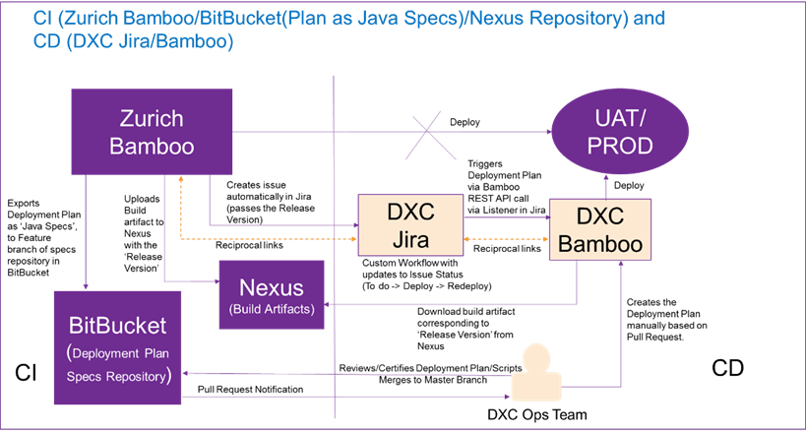

Slide 3
Steps for Onboarding Process
The Zurich team is responsible for the CI Part. The DXC Team is responsible for the CD Part.
We must set up communication links between all the applications that we use
(Zurich Bamboo <-> DXC Jira
DXC Jira <-> DXC Bamboo
Zurich Bitbucket <-> DXC Bamboo(Linked repository)
Nexus -> DXC Bamboo)

Slide 4
The Zurich Team saves its deployment plans as a Java specifications file on Zurich Bitbucket.
The build artifacts together with the release version are uploaded to NEXUS by the Zurich Team after successful deployment in DEV environment.
The Zurich Team specifies us the details of the service to be onboarded.
We retrieve the relevant service details, including the project name and key, by verifying the relevant service details in Zurich Bitbucket repository.
In DXC Bamboo, we construct a build plan (UAT) using the same project name and key available in the Bamboo Java specificaiton file in the Bitbucket repo.

Slide 5
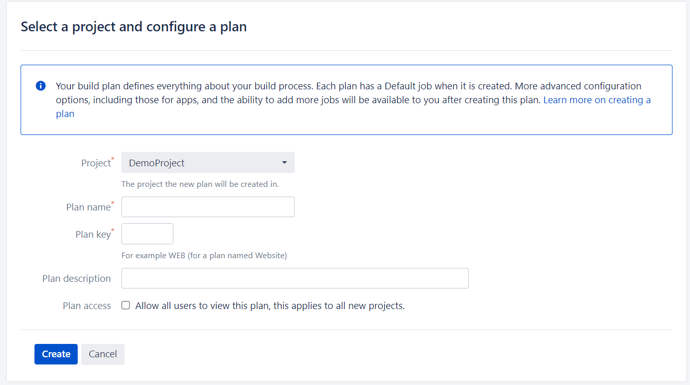
Following the creation of the build plan, we perform a Bamboo scan to match the service (from bitbucket) and import the deployment plan into DXC Bamboo.
Two tasks are added to the build plan.
Create a .properties file.
Inject bamboo variables.
We repeat the same steps for PROD Environment.

Slide 6
We create a project in DXC JIRA and send the Zurich Team the Curl script which includes JIRA project key, UAT/PROD plan logs links.
Sample CURL script
curl -D- -u "PAT code" -X POST --data "{\"fields\":{\"project\": {\"key\": \"HELLOWS\" }, \"summary\": \"${bamboo.planName} - ${bamboo.buildNumber}\", \"customfield_11601\": \"${bamboo.planKey}-${bamboo.buildNumber}\", \"customfield_11600\": \"${bamboo.proj.pom.releaseVersion}\n\", \"description\": \"Link to the build:\n${bamboo.resultsUrl}\n Link to UAT Deployment logs:\n https://bamboo-uat.dxc.zurich.com/browse/RT-HELLOWSUAT/deployments \n Link to PROD Deployment logs:\n https://bamboo-uat.dxc.zurich.com /browse/RT-HELLOWSPROD/deployments \n \",\"issuetype\": {\"name\": \"Task\"}}}" -H "Content-Type: application/json" -k https://jira-uat.dxc.zurich.com/rest/api/2/issue/

Slide 7
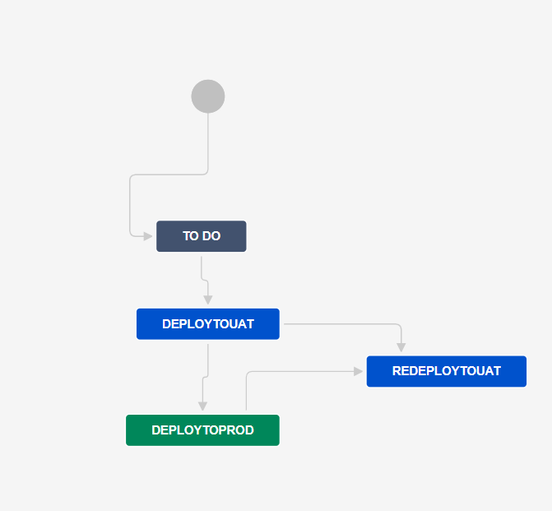
This curl script makes sure that an Issue in DXC JIRA is automatically created following each successful deployment.
The "workflow listener" is a custom plugin made by DXC Team.
The plugin causes an automatic deployment in DXC Bamboo whenever the issue state is changed from one state to another (TODO -> DeploytoUAT or DeployToUAT -> DeployToProd) in DXC JIRA.
We update the JSON with new information including the Project key, UAT key and PROD key.

Slide 8

Thank you

